Slide 1
Secure Your Cloud with Confidence
Defend against Threats with Microsoft Sentinel
David Branscome
dabran@microsoft.com

Slide 2
Agenda
Using Jupyter Notebooks for Threat Hunting
Microsoft Defender for Threat Intelligence (MDTI)
Defender External Attack Surface Management (EASM)

Slide 3
Using Jupyter Notebooks for
Threat Hunting

Slide 4
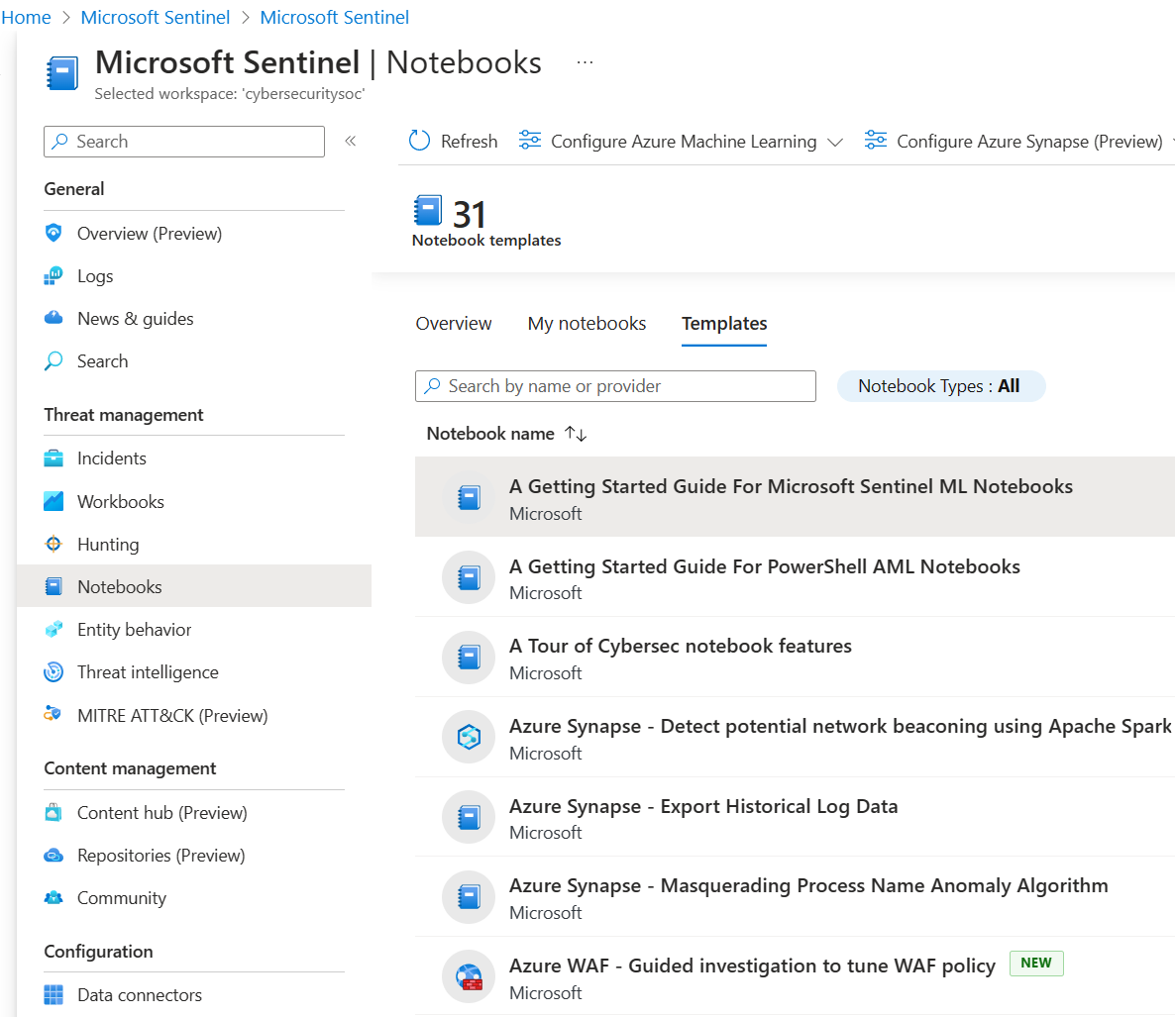
What are Jupyter Notebooks?
Jupyter Notebooks are NOT a Microsoft product, but they are used in Sentinel (and other products)
Open-source web applications based on JUlia, PYThon and R
Notebooks are documents that contain live code, equations, visualizations, and narrative text
Originally used for data science, stock market predictions, astronomy, etc…but have found a niche in cybersecurity

Slide 5
How to leverage Jupyter Notebooks with Sentinel
Storage of investigation artifacts
  Store and collect evidence to improve response time for next event
Interactive scripting tool
  Can be used to process stored scripts and store results inline for investigations
Interoperability with multiple programming interfaces
  Enable deeper programmatic abilities to connect to, use and store external data
Use as training or standardization guides
  Leverage notebooks to guide analysts through steps of a threat hunt or investigation dynamically

Slide 6
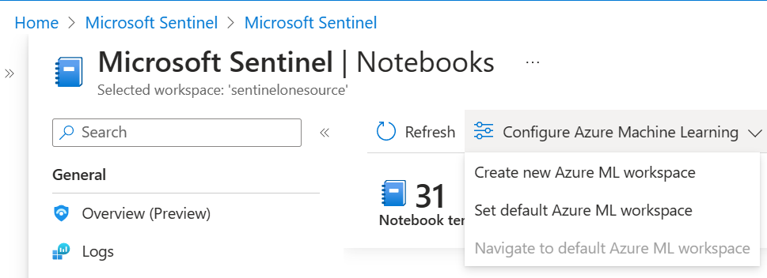
Setting up your Azure ML Workspace
Requirements:
  At least Microsoft Sentinel Contributor role to save and launch notebooks
  Resource-group level Owner or Contributor role to create a new Azure Machine Learning workspace
Create a new Azure ML workspace.
Use a public endpoint to avoid issues with network communication

Slide 7
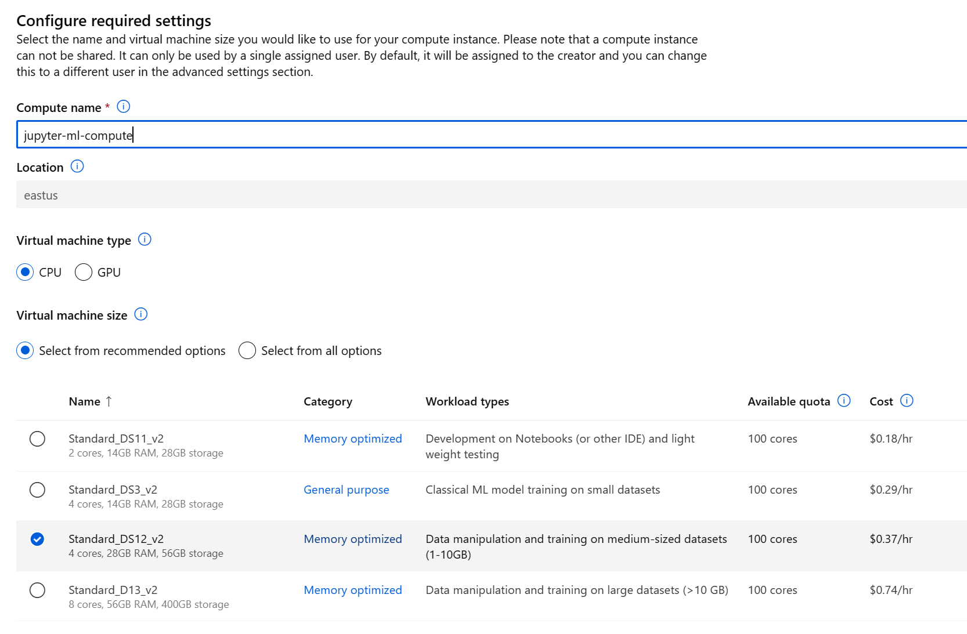
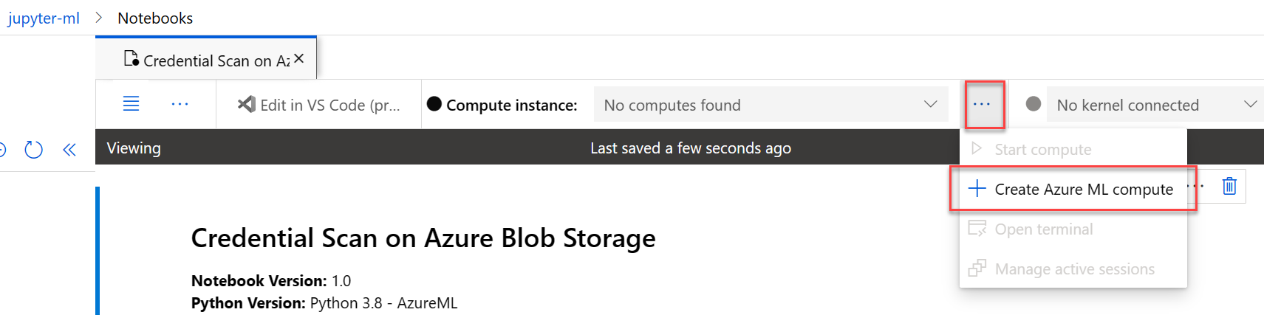
Assign a compute resource to the ML workspace
Create an Azure ML compute resource that will be used to run the notebook
Compute resources have different sizes and can handle different types of ML workloads (e.g., compute vs. memory-intensive)

Slide 8
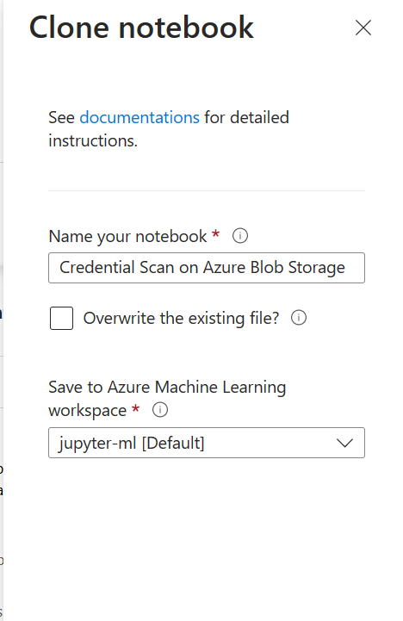
Using a built-in Jupyter Notebook
Cloning a Notebook and making small adjustments can be an easy way to start learning
Rename and clone an existing built-in notebook and save it to an ML workspace
Once the notebook is cloned, you’ll need to assign compute resources to the notebook.

Slide 9
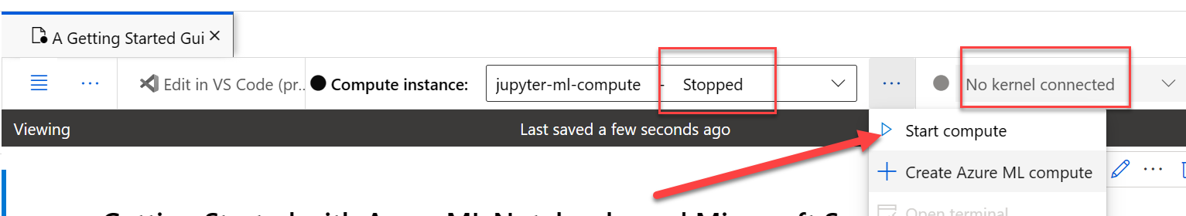
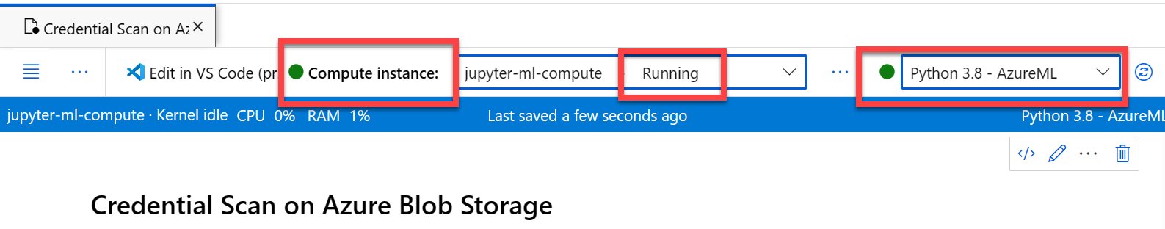
Start/stop the compute resource
Stop and start the compute resource to reduce spend
Once the compute instance is running and the kernel is connected, you can run the notebook

Slide 10
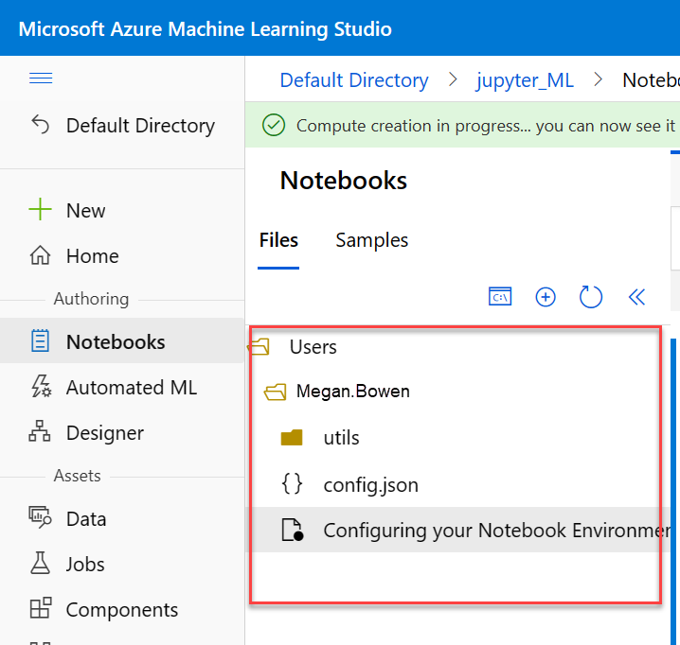
Default workspace directory structure
The working directory for my Azure ML workspace looks like this by default.
This will be important when we want to add more Notebooks to our Sentinel instance

Slide 11
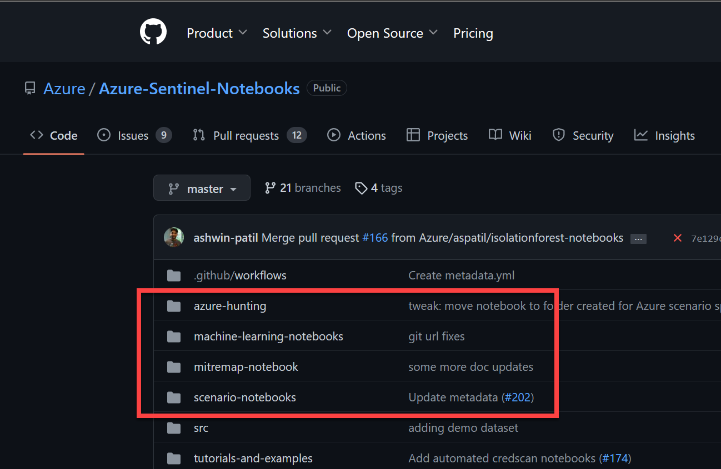
Getting New Sentinel Notebooks
Sentinel Product Group creates new Notebooks and stores them on their GitHub repo
They are not all integrated into your Sentinel instance.
How do you get them over?

Slide 12
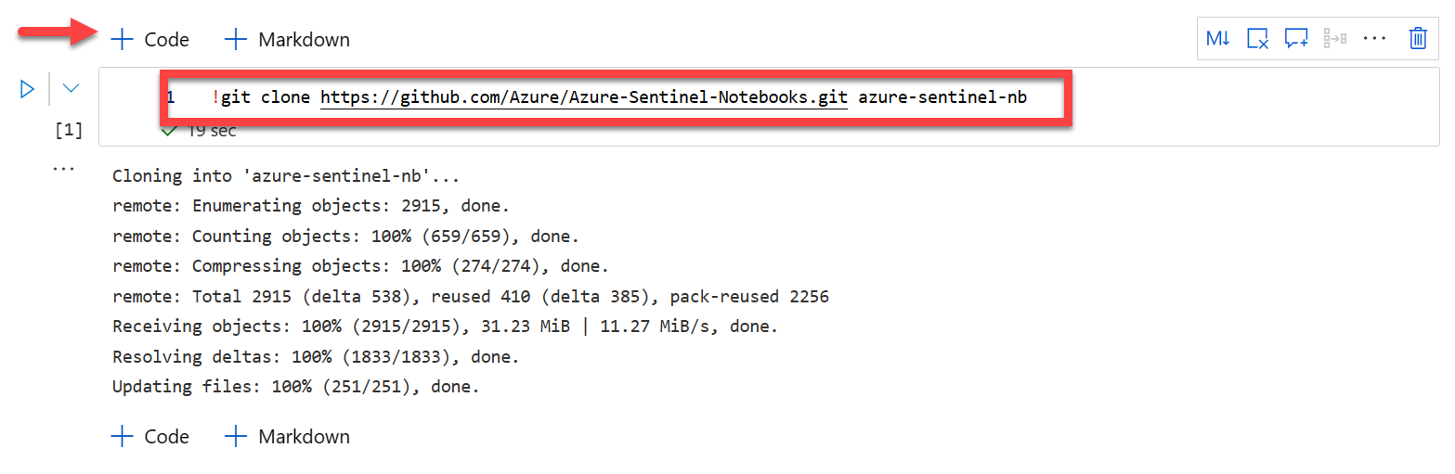
Download Notebooks to your Sentinel environment
You can download all the Microsoft Sentinel team’s Jupyter Notebooks and add them to the Notebooks collection in your Sentinel instance
Open any Notebook, click on “+ Code” to create a new cell, and run the code shown below. It will download all the Microsoft Sentinel Notebooks from the Sentinel GitHub repository to your ML workspace.

Slide 13
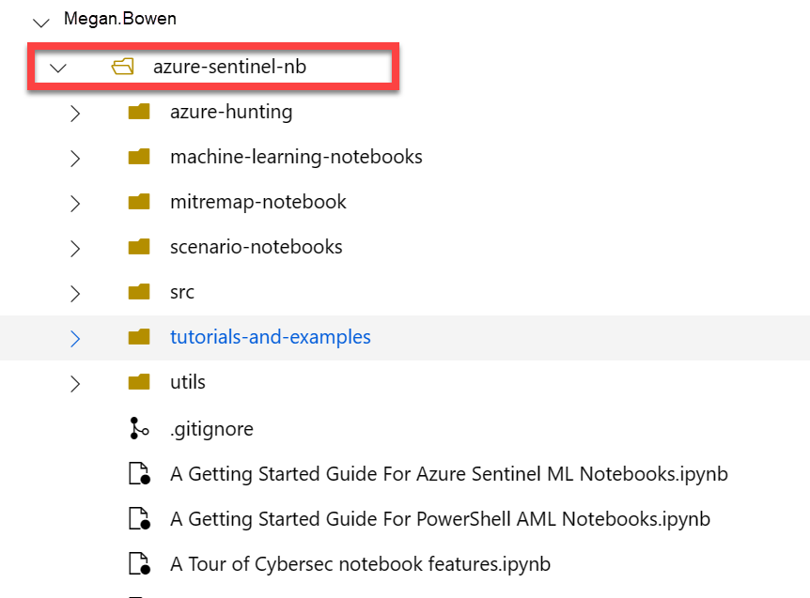
Copy GitHub contents to your ML working directory
The notebooks that you downloaded get stored in the azure-sentinel-nb directory of the user folder in your Azure ML workspace
You now need to copy the new notebooks out of the azure-sentinel-nb workspace, since these are not yet visible in Sentinel.

Slide 14
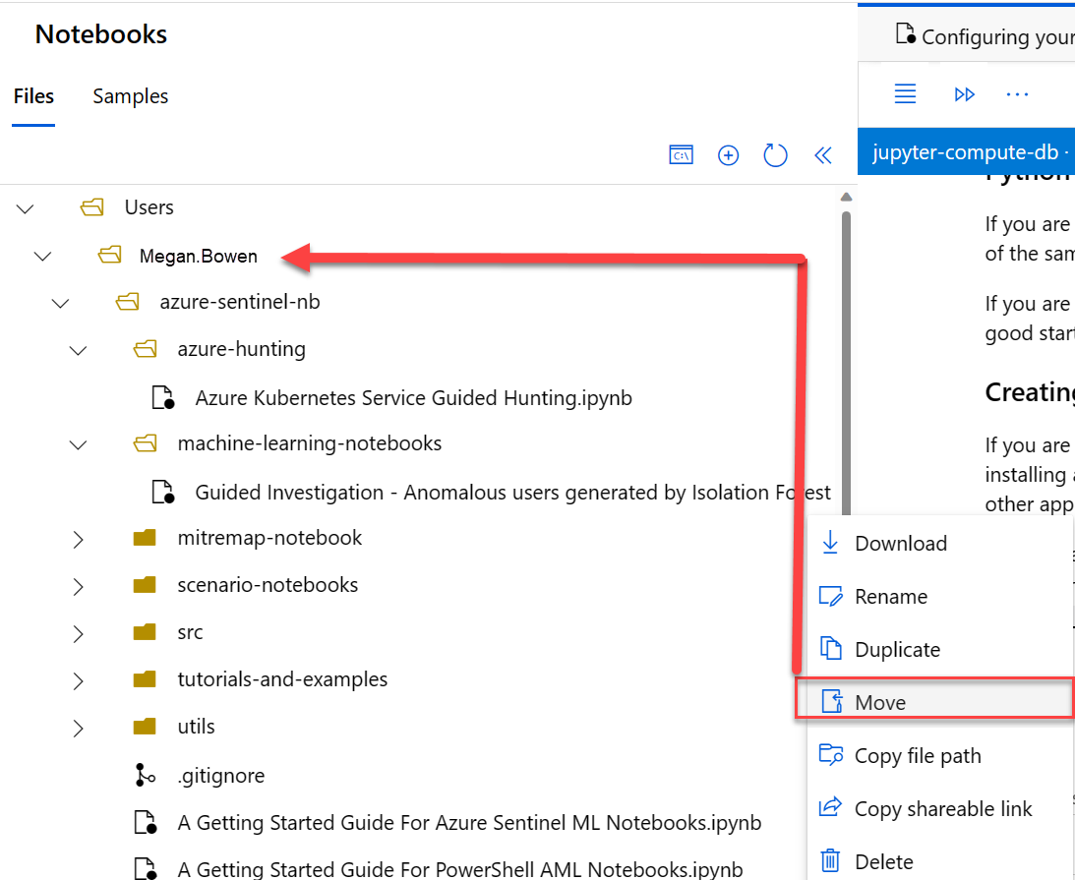
Move notebook to your working directory
Select a notebook from the folder under the azure-sentinel-nb location (e.g., “Guided investigation – Anomalous...”)
Click on the ellipsis on the right side of the Notebook name and select “Move”
Move the Notebook to the working directory (Megan.Bowen in this image)
Automation is a better option, obviously

Slide 15
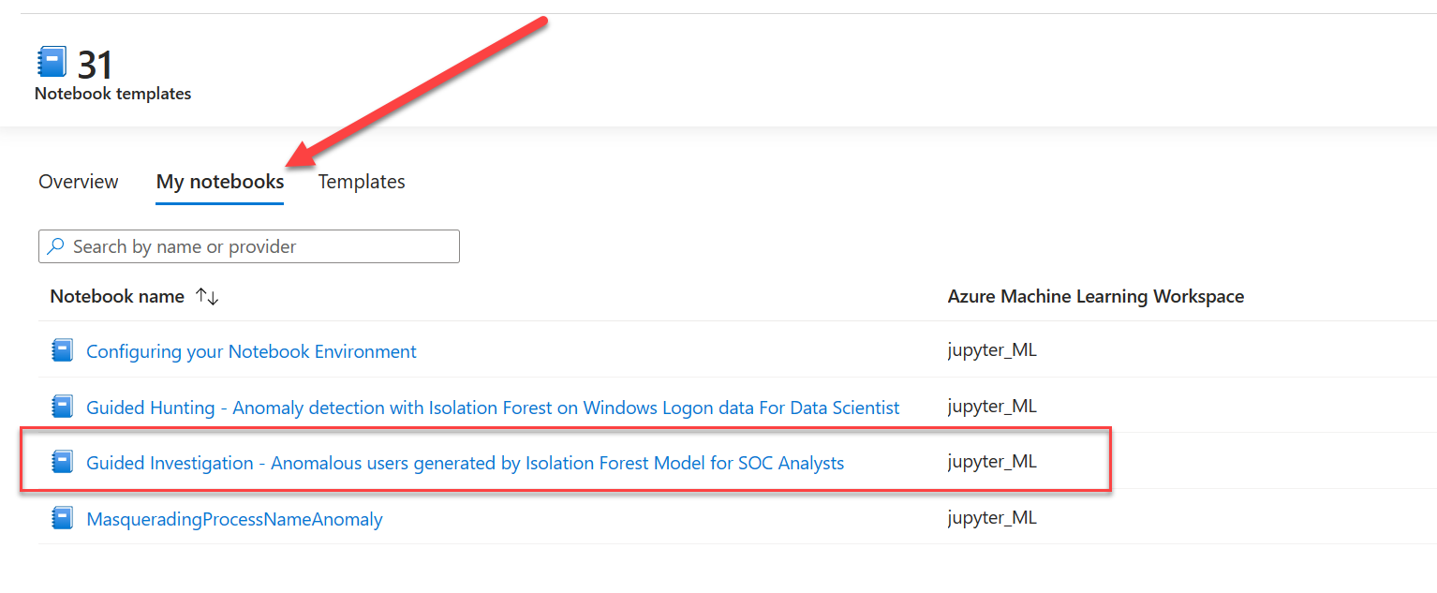
Check “My Notebooks” for the new notebook
Next, check your “My Notebooks” tab. The new notebooks should show up there and can be used.

Slide 16
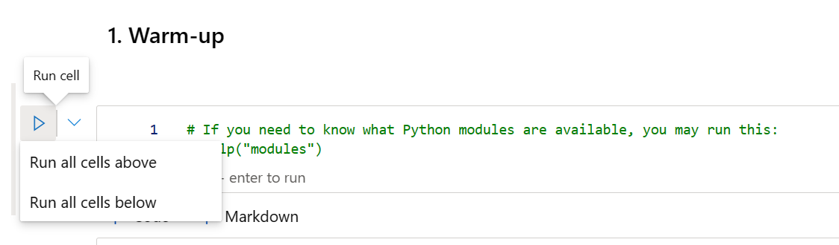
Running Jupyter Notebooks
Blocks of code in the notebook can be run one step at a time, or you can run blocks of code in sequence.
However, don’t run them out of sequence, since code blocks often rely on data from previous blocks as input

Slide 17
DEMO
Move Jupyter Notebooks to Sentinel from your ML workspace

Slide 18
Microsoft Defender Threat Intelligence

Slide 19
Microsoft Defender Threat Intelligence
Protect your organization from adversaries with a 360-degree view of your threat exposure
Identify adversaries and their malicious infrastructure at a global scale. Understand vulnerabilities from endpoint to the internet.
Accelerate remediation with internet threat intelligence. Uncover exposures to ensure full removal of attackers and reduce the risk of double extortion.
Integrate with existing security infrastructure to enhance prevention and improve your posture.
Identify
Accelerate
Integrate

Slide 20
  MDTI Common Use Cases
Security operations
Using data collected from a variety of defense tools to analyze events occurring within an environment to mitigate threats
Incident response
Investigating, analyzing, and responding to cyber incidents within
a network or enclave
Threat hunting
Proactively searching for malware or attackers hiding within a network
Cyber threat intelligence analysis
Identifying and tracking cyber threats to an organization and working
with stakeholders to reduce risk
Cybersecurity research
Developing new concepts or novel approaches to identify and defend
against cyber threats

Slide 21
Defender TI Features
Key Value Propositions
Intelligence Articles. Centralized collection of public OSINT and private expansion of related infrastructure indictors. Original Microsoft research articles from our multiple threat, response, and research teams
Advanced Investigations. Expansive modern data sets to connect adjacent and related attacker infrastructure to eliminate missed threats. Datasets include Passive DNS, WHOIS, SSL certificates, cookies, hosts and host pairs, domains, IPs, and services running.
Projects. Allow collaboration and reuse of prior investigations history across an individual or team. This aids in reducing response times and discovery of related attack infrastructure as threat actors TTPs shift.
Reputation Scoring. Dynamically calculated severity scoring and analyst guidance for internet infrastructure to aid in decision making and response process times.

Slide 22

How does it work – graph the internet
Threat actors are intelligent and constantly changing their tactics:
Web crawlers
Scripted and random
interactions
Active and
passive sensors

Slide 23
Observe the internet through the eyes of an attacker
In a threat campaign threat actors might…
  Target specific types browsers and/or versions
Threat actors can filter traffic from target organizations and security vendors to stay hidden from detection
  Target specific regions of the world
  Target specific types of IP space
  (residential, commercial, mobile)
Therefore, we must try to act like the intended victim and avoid detection, just like the threat actor does

Slide 24
How to blend in to map the internet to find bad stuff
Interact with internet assets via a multitude of different perspectives
Virtual user
Browser diversity
Global proxies
IP space
Different browsers
Various versions
Mobile and desktop versions
Thousands of egress points from different geolocations to emulate traffic from different countries
Residential
Commercial
Mobile

Slide 25
Interacting like a user from a browser perspective
We also see
the internet like
a user does.
When the page is rendered in the browser the full Response and DOM (Document Object Model) are captured.
This allows for understanding
of dependent requests, cookies, headers, links, causes, sequences of how the page was actually loaded.
We hash the DOM and compare it to all the other DOM we have seen. We can then use the hash signatures to identify website similarity at a global internet scale.

Slide 26
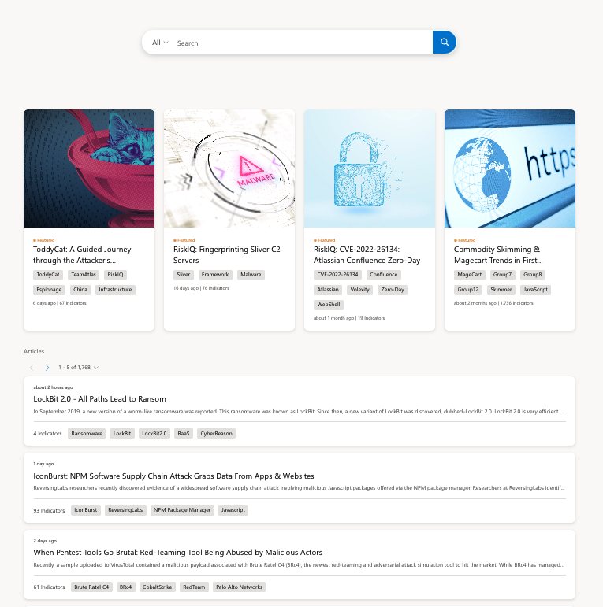
Home page
1
Learn about new security topics in the form of articles or to research intelligence they have found elsewhere.
  Search is the gateway to the vast amount of data available should you want to dive in with data you want to turn into intelligence.
  Featured articles are key research publications that we find relevant based on our intelligence expertise..
  Articles ensure every customer has data to hunt with across all verticals and topics.
2
1
3
2
3

Slide 27
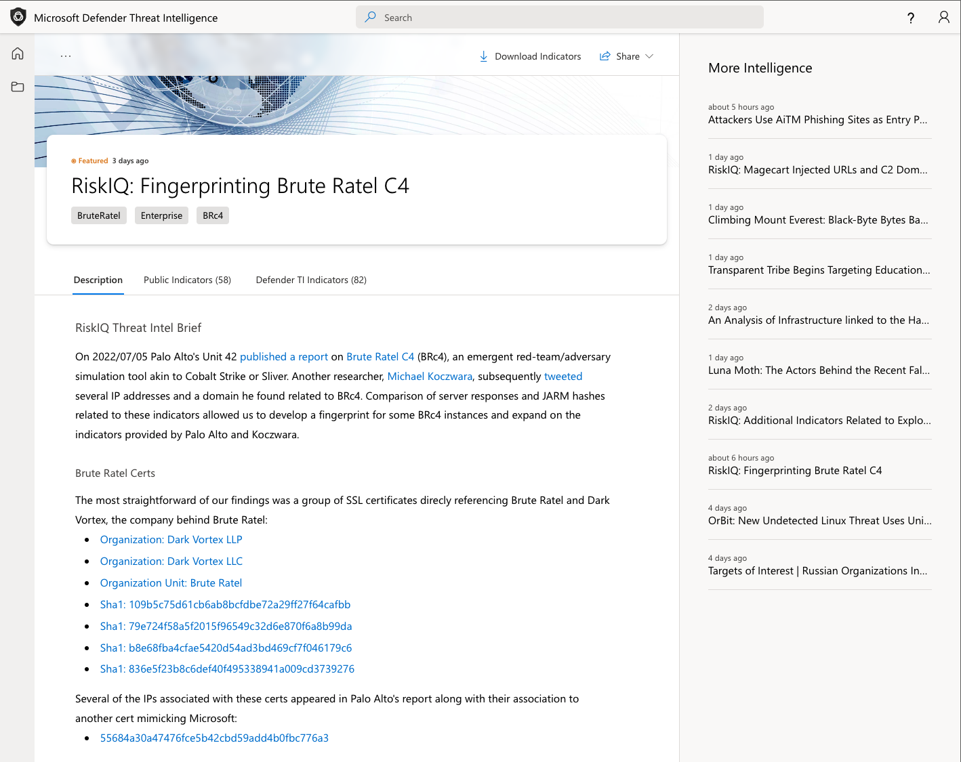
Articles
Feature summary
Analytic view of intelligence research
Coverage of new techniques observed in the wild, as well as recommendations for pivot and hunting points

Slide 28
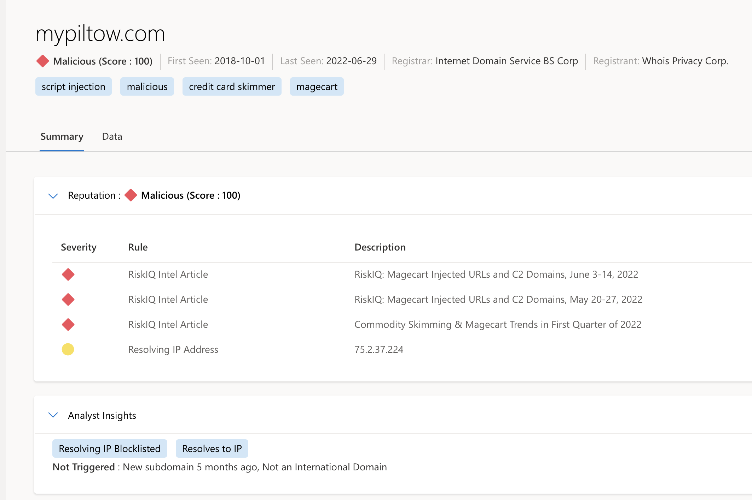
Summary view
Search results
Use case: Suspicious Domain Research
  Search results are output into two tabs:
  Summary provides key insights about an artifact that the platform has derived from expansive datasets.
  Data is pure investigative content where a customer can extrapolate and start to connect artifacts based on a deep dive analysis.
1
1
2
2

Slide 29
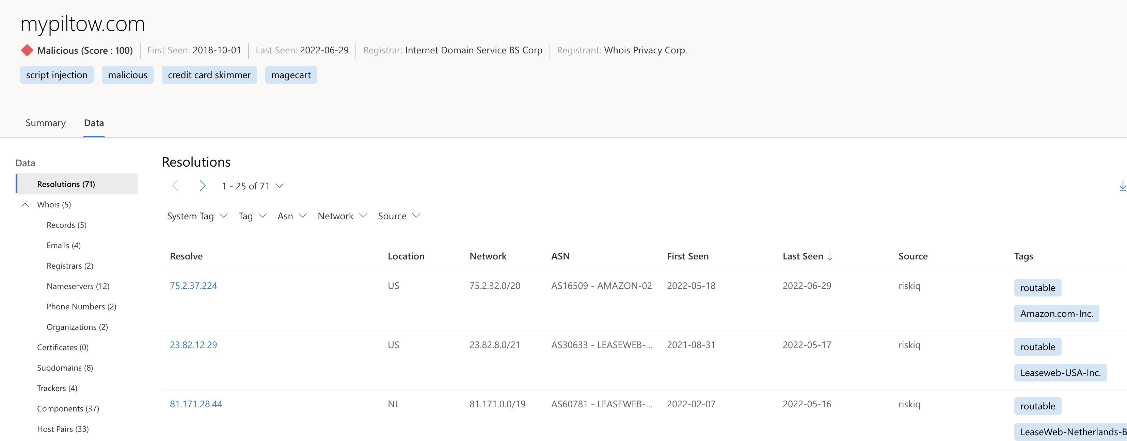
Data view
Search results
Use case: Suspicious Domain Research

Slide 30
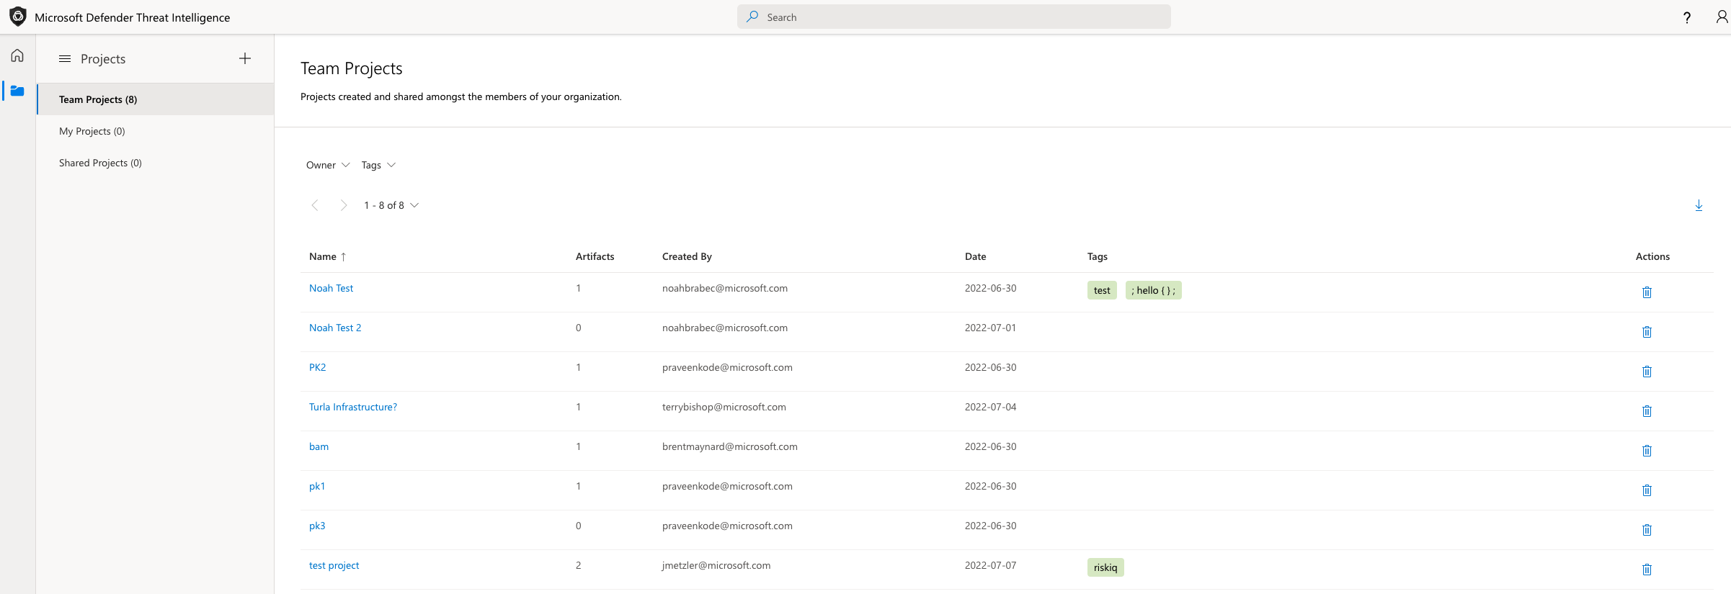
Projects
Organizing investigations

Slide 31
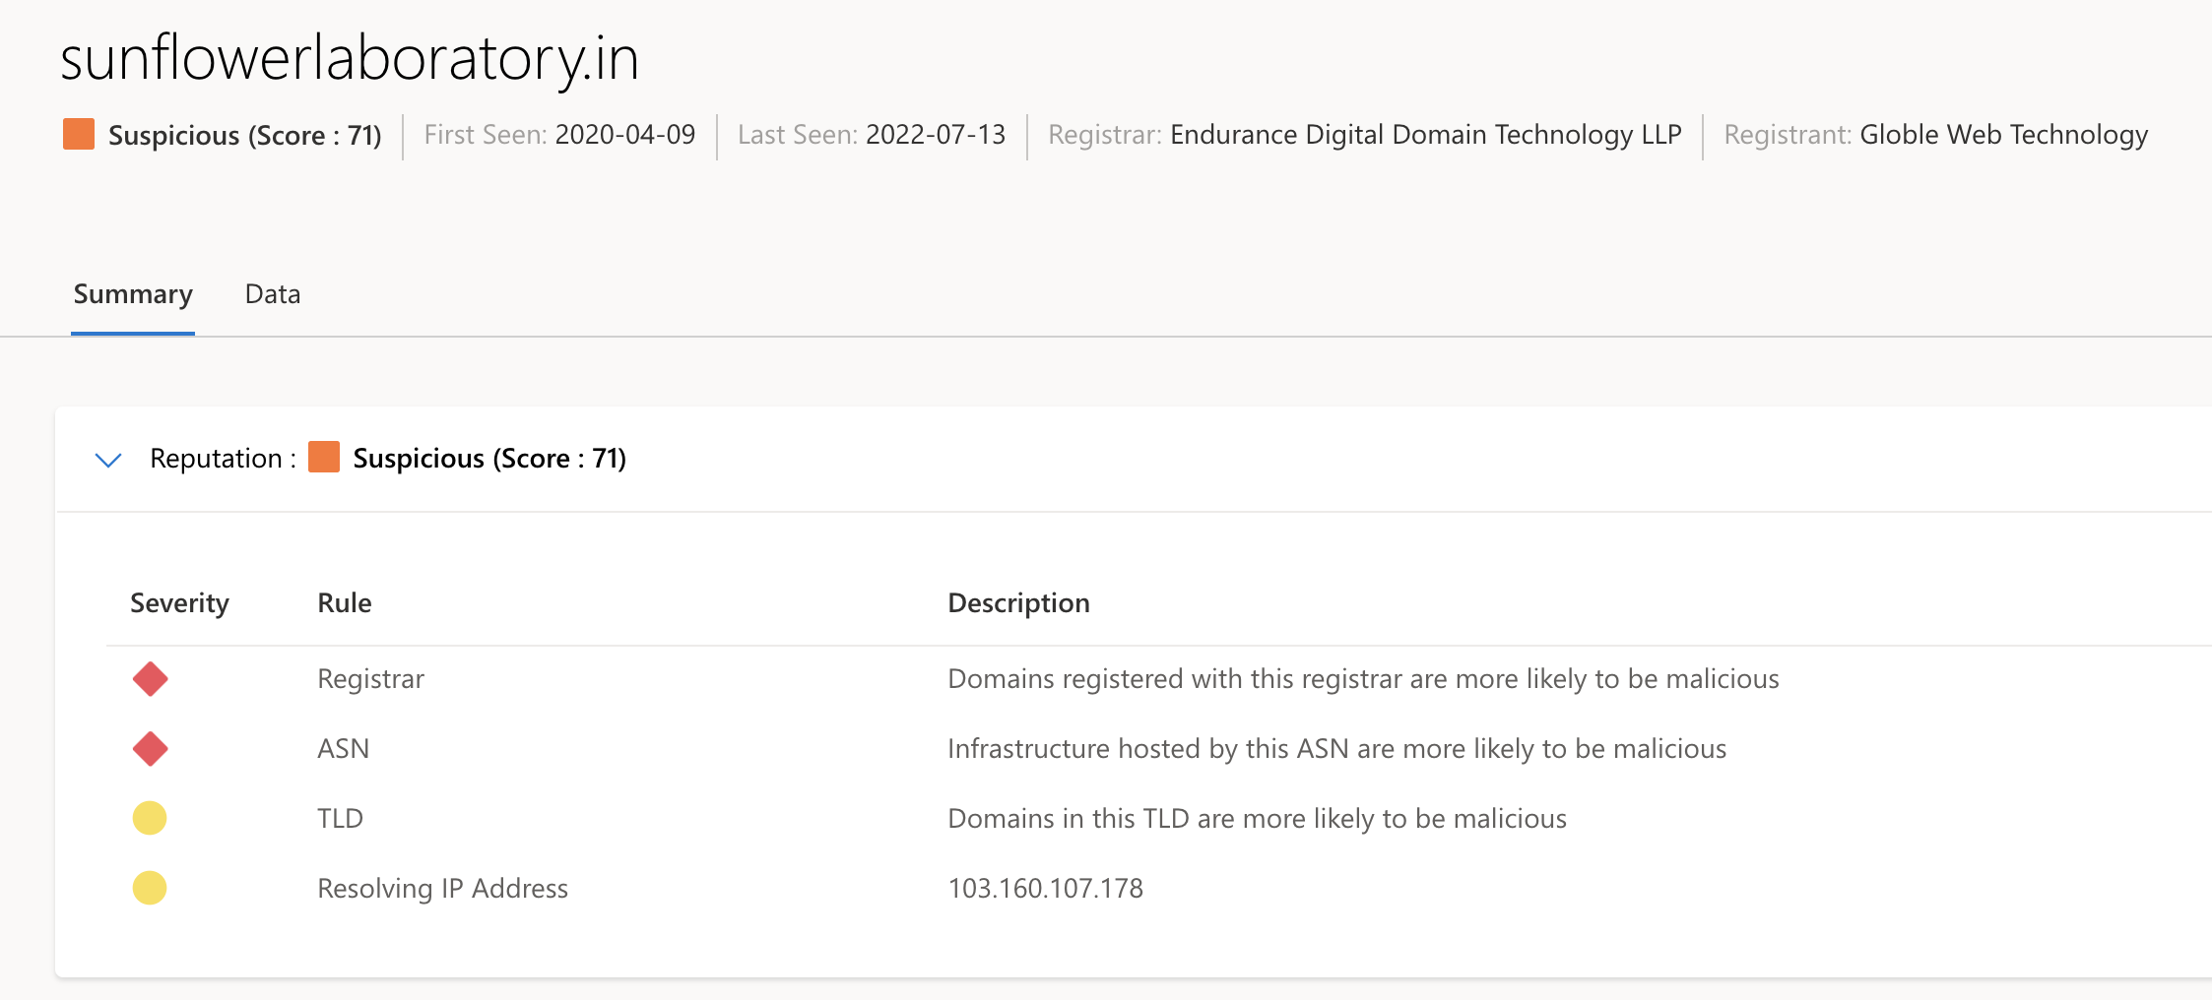
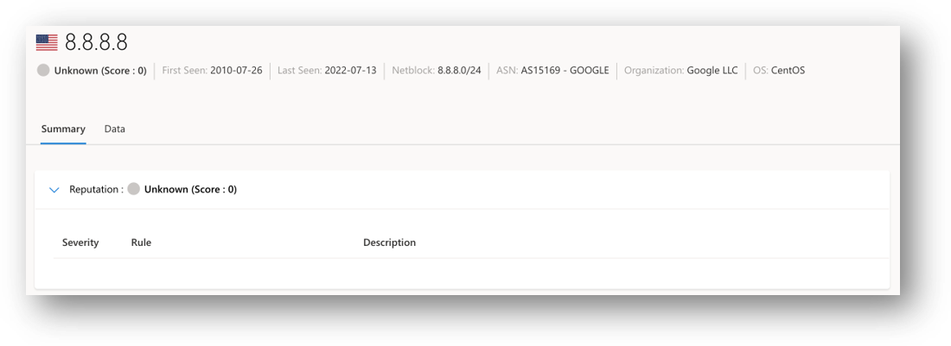
Reputation scoring
Feature summary
Hosts, Domains, and IP Addresses are grouped into categories depending on their numerical reputation score.
Characteristics include:
  First seen
  Last seen
  ASN
  Country
  Associated infrastructure

Slide 32
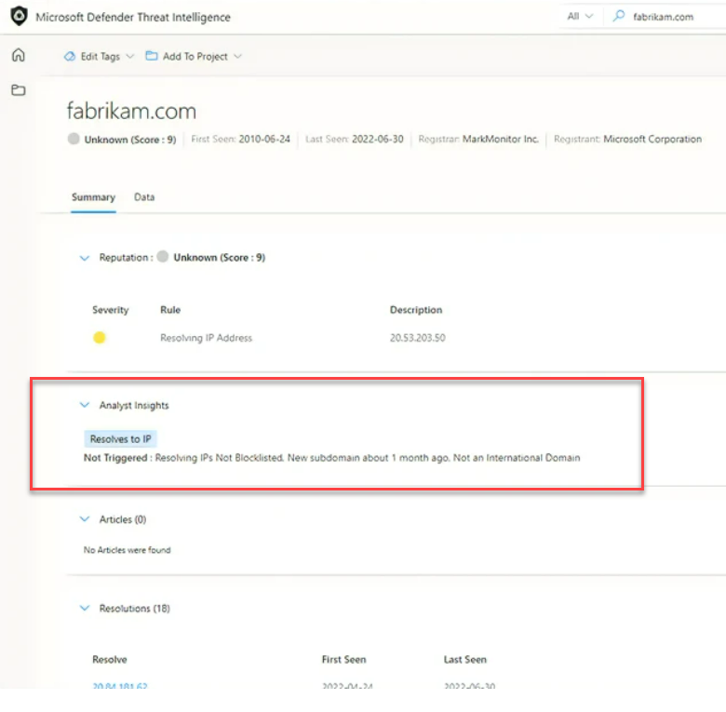
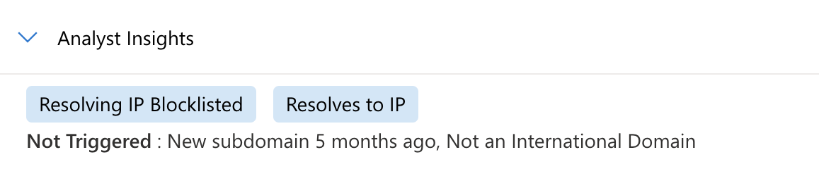
Analyst Insights
Feature summary
  Lists any insights that apply to artifacts.
  Also shows rules that were not triggered, which can help move investigations along faster

Slide 33
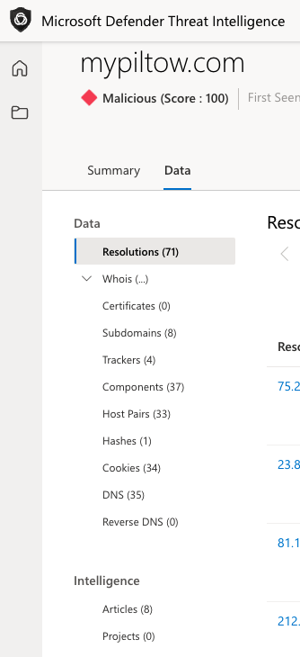
Datasets
  Includes information related to DNS, certificates used, host pairs, subdomains, file hashes and many other data elements.
  Can help answer questions such as:
  Is the IP address routable?
  Where is the IP address geolocated?
  How old is the domain?
  What name servers are used?
  Is this a sinkhole domain?
  Are there fake names in the WHOIS record?
  Is it using a self-signed certificate?
  Etc….

Slide 34
DEMO
Microsoft Defender Threat Intelligence

Slide 35
Microsoft Defender
External Attack Surface Management

Slide 36

What is your external attack surface?
Everything that an attacker can see on the internet with little risk that they’ll be detected by defenders.

Slide 37
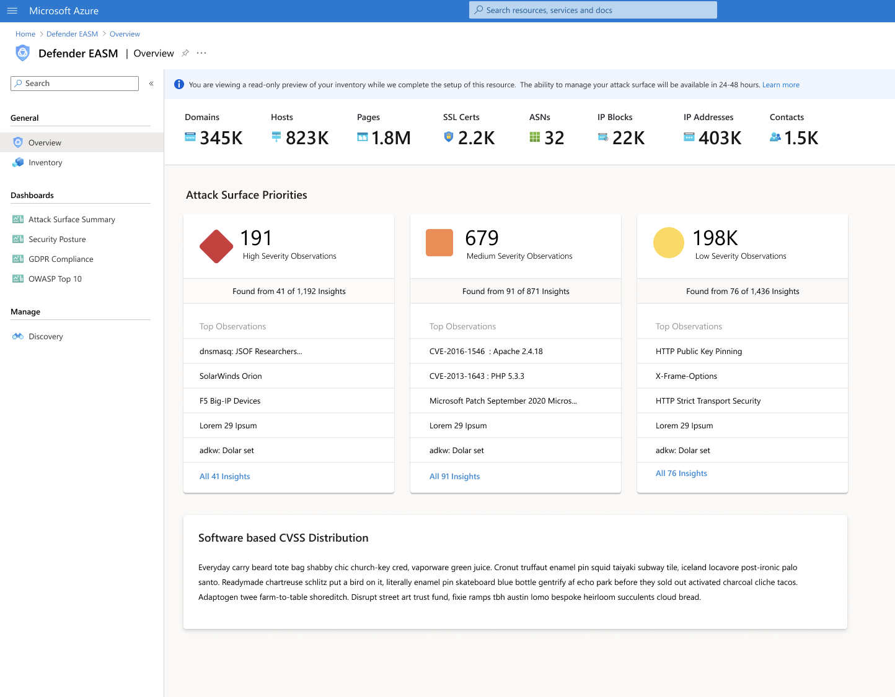
Overview of Defender EASM
Discovers and maps your digital attack surface
Provides teams with ability to identify unknowns, prioritize risks, eliminate potential attack vectors, and extend vulnerability management beyond the firewall

Slide 38
Key concepts
Assets
An external-facing online entity owned and controlled by your organization. Asset types include domains, hosts, pages, IP blocks and addresses, contact emails, ASNs, and SSL certificates.
Discovery
Process that maps an organization's infrastructure by detecting connections
to known assets. Note that this process maps connections based on our
pre-existing comprehensive map of the internet. Any discovered assets are already included in this map but will be refreshed and mapped to the customer.
Seeds
Known assets attributed to your organization, which kickstart the discovery process. Discovery investigates the connections that seeds have to other infrastructure to define your Attack Surface.
Attack Surface
An organization's infrastructure that is exposed to the open internet. Your attack surface is defined through the discovery process; users can use multiple discovery runs to compile a single
Attack Surface.
Inventory
Your indexed list of known assets, which is regularly monitored to detect any changes.
Attack surface insights
A series of dashboards that alert users of any risks to their attack surface (e.g., GDPR violations,
CVE vulnerabilities).

Slide 39
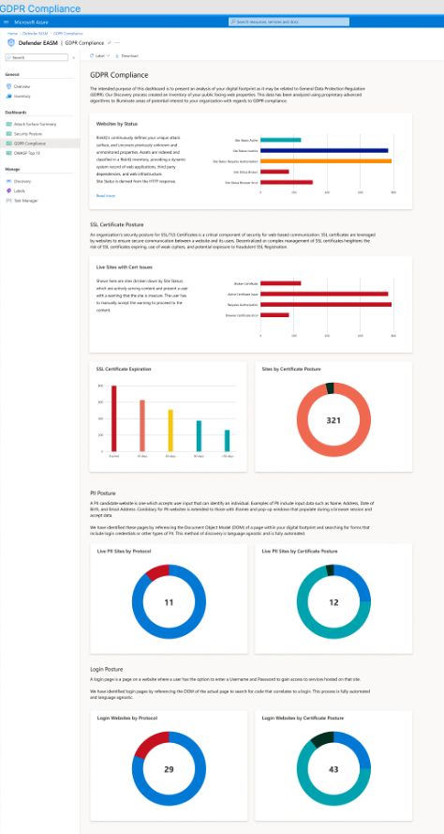
Dashboards
Feature summary
MDEASM has four pre-defined dashboards with use-case based information that a customer can use in analyzing their inventory and assessing risk:
Attack Surface Summary
Security Posture
GDPR Compliance
OWASP
Top 10
These dashboards are comprised of details from the Approved Inventory. Inventory in other states are not included.

Slide 40
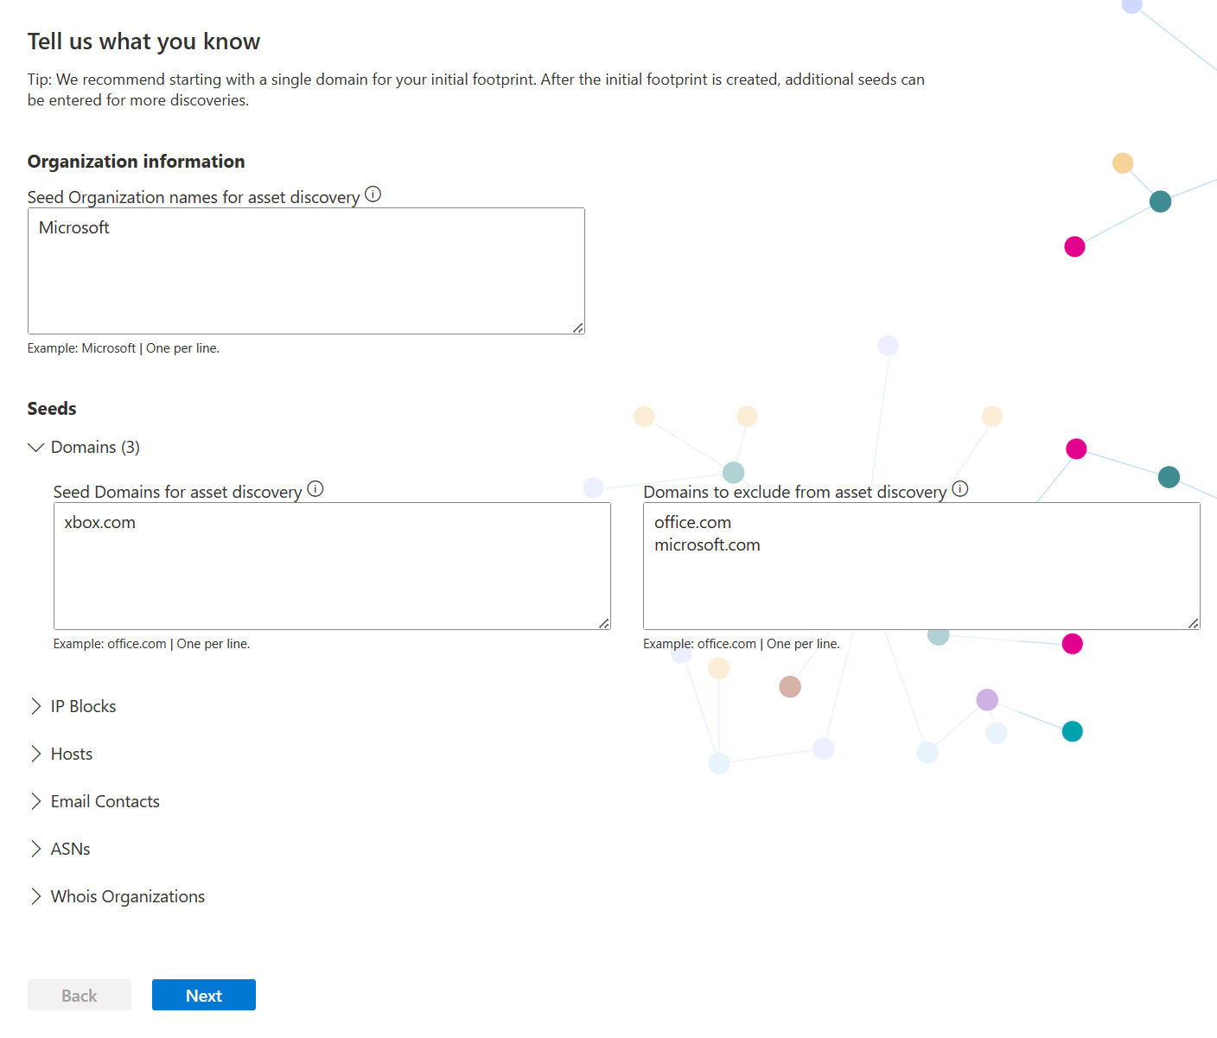
Creating an EASM Azure Resource
Two steps involved:
  Create a resource group
  Create an EASM resource in the resource group
Creating the EASM can be done 2 different ways:
  Select attack surface of one of 25,000 organizations already mapped
  Create a custom discovery, providing “seed” information” (domains, hosts, IP’s, etc…)
Building the attack surface will take 24-48 hours

Slide 41
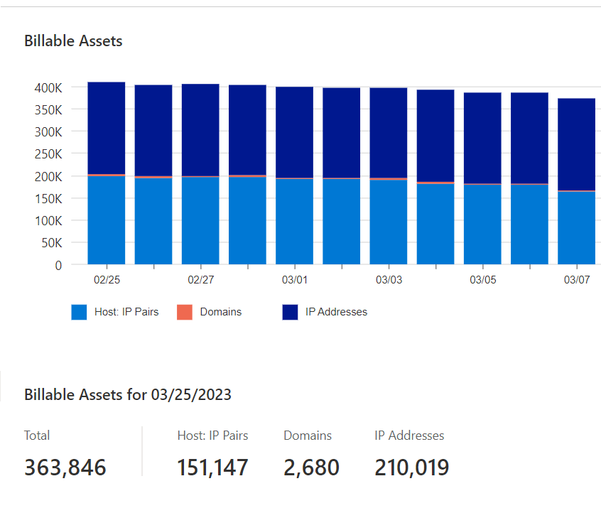
Understanding inventory assets and billing
After onboarding EASM, customers get a 30-day free trial, after which they are charged for billable assets
Only approved asset types are considered billable:
  Approved hosts
  Approved domains
  Approved IP addresses

Slide 42
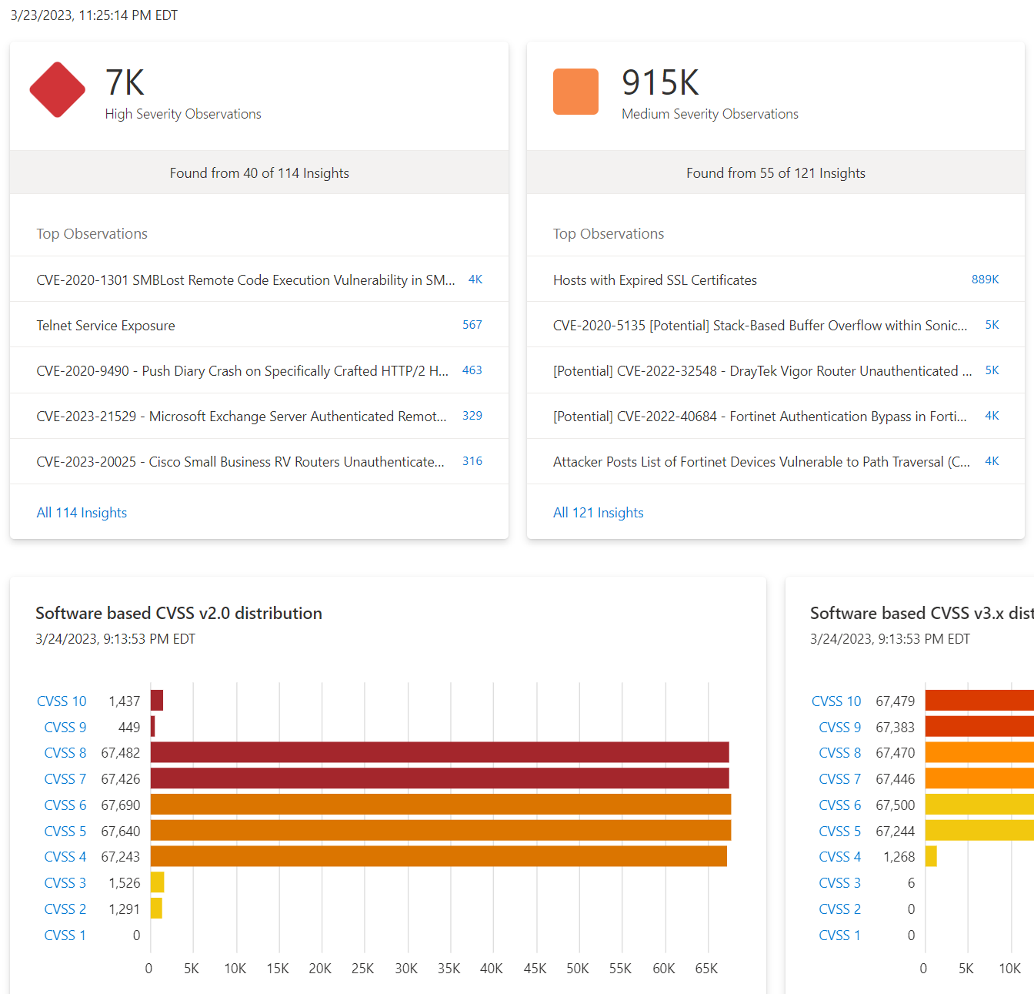
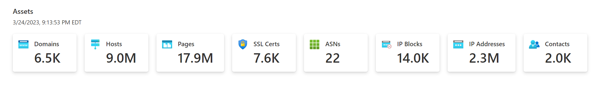
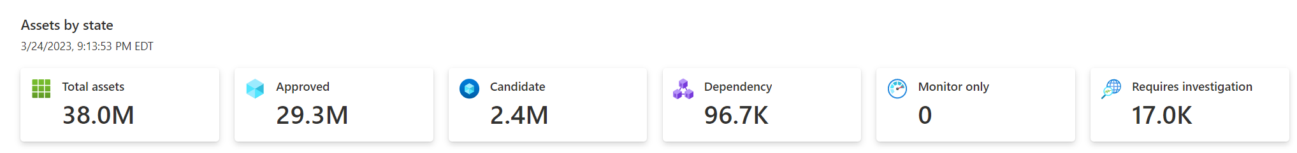
Viewing the attack surface
Results are presented by:
  Asset type
  Queryable inventory
  Dashboards to evaluate your Security Posture & Risk

Slide 43
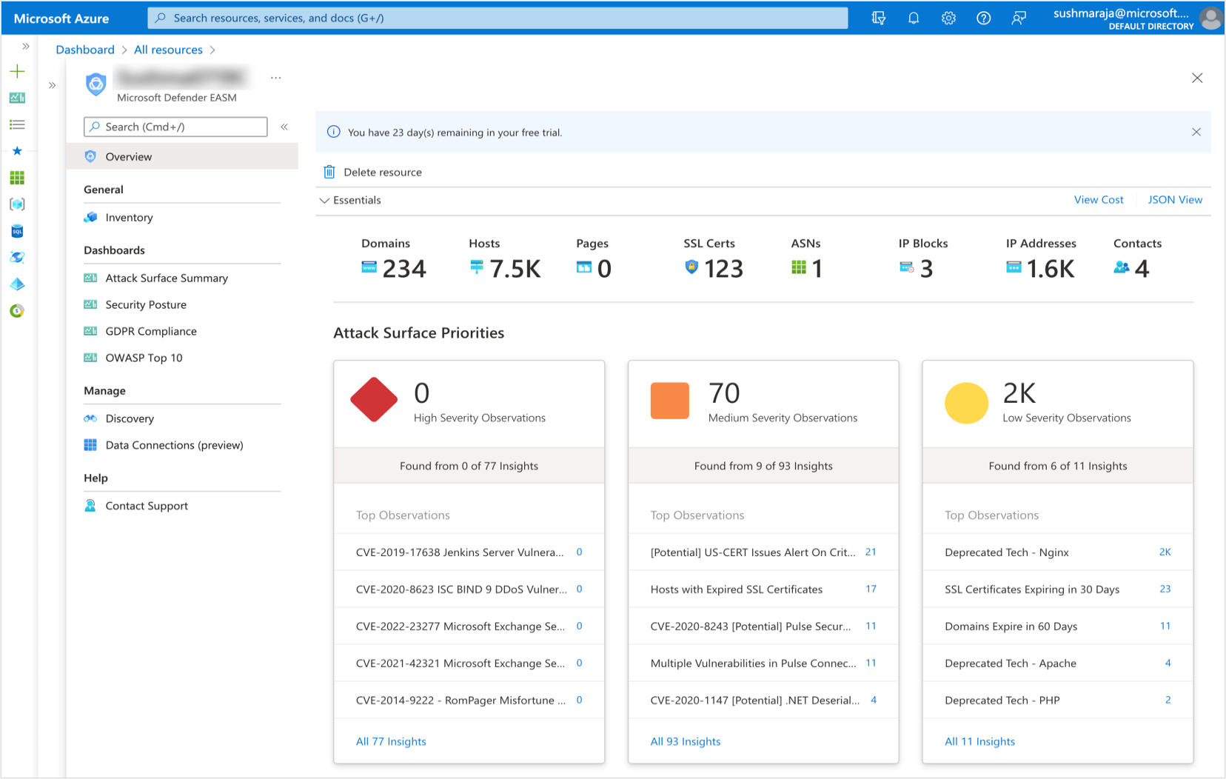
Deleting a resource
You can delete the resource within the resource itself or at the subscription level.
To delete the resource from the resource:

Slide 44
DEMO
Defender for External Attack Surface Management

Slide 45
Thank you

